Slide 1


Real-Time Language Translator: Bridging Language Barriers
Welcome to our presentation on real-time language translation! We'll explore the functionality, technologies, platforms, and innovations that are shaping the future of communication.
by Kollipara Jaswanth

Slide 2

Introduction
Imagine a world where language barriers no longer exist, where seamless communication is possible across cultures. Real-time language translation is making this vision a reality.
Globalization has fueled an increasing need to overcome language barriers. Whether it's for business, travel, education, or simply connecting with others, the ability to communicate in real-time across languages is becoming increasingly important.
1
Globalization
The interconnectedness of the world necessitates bridging language barriers.
2
Seamless Communication
Real-time language translation enables fluent and efficient communication across language divides.
3
Breaking Barriers
Translation technology removes limitations, fostering collaboration and understanding.

Slide 3
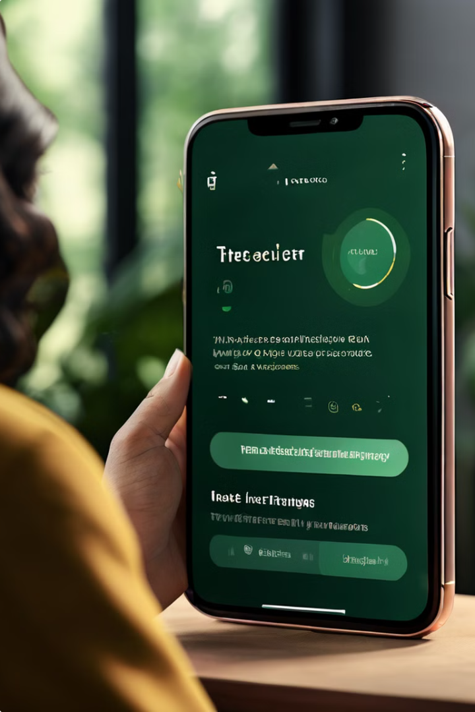
Functionality
Real-time language translators are software or hardware solutions that convert spoken or written language instantly into another language. They act as bridges, enabling people to communicate naturally, regardless of their native tongues.
Instant Translation
Language conversion happens instantaneously, making real-time communication possible.
Multi-language Support
These translators handle numerous languages, covering a wide range of global communication needs.
Voice and Text Translation
They support both speech and text input, catering to various communication preferences.
User-Friendly Interface
The interfaces are designed for ease of use, making translation accessible to everyone.

Slide 4
Core Technologies
Behind the seamless translation lies a sophisticated interplay of technologies. These components work together to process human language, convert it between formats, and deliver accurate translations.
Natural Language Processing (NLP)
Speech-to-Text
Text-to-Speech
Translation Engine
This component converts spoken language into written text, enabling the translator to process spoken words for translation.
This component synthesizes speech from text, allowing the translated text to be spoken aloud.
The heart of the translation process, this engine uses algorithms to convert text from one language to another.
NLP analyzes and understands human language, allowing the translator to interpret the meaning of words and phrases.

Slide 5

Platforms
Real-time language translation is available across various platforms, offering flexibility and accessibility for diverse user needs.
Platform
Description
Example
Software Applications
Apps designed for mobile and desktop devices.
Google Translate
Hardware Devices
Dedicated devices specifically designed for translation.
Pocketalk
Web-Based Platforms
Online services accessible through web browsers.
Microsoft Translator

Slide 6





Machine Learning
The core of real-time language translation is machine learning, which enables continuous improvement and sophistication.
Supervised Learning
Unsupervised Learning
Reinforcement Learning
Continuous Learning
Models are trained on labeled data, where input and output language pairs are provided.
Translation models constantly adapt and improve with exposure to new data and user feedback.
Models discover patterns in unlabeled data, finding hidden relationships between languages.
Models learn through feedback, receiving rewards for accurate translations and penalties for errors.

Slide 7
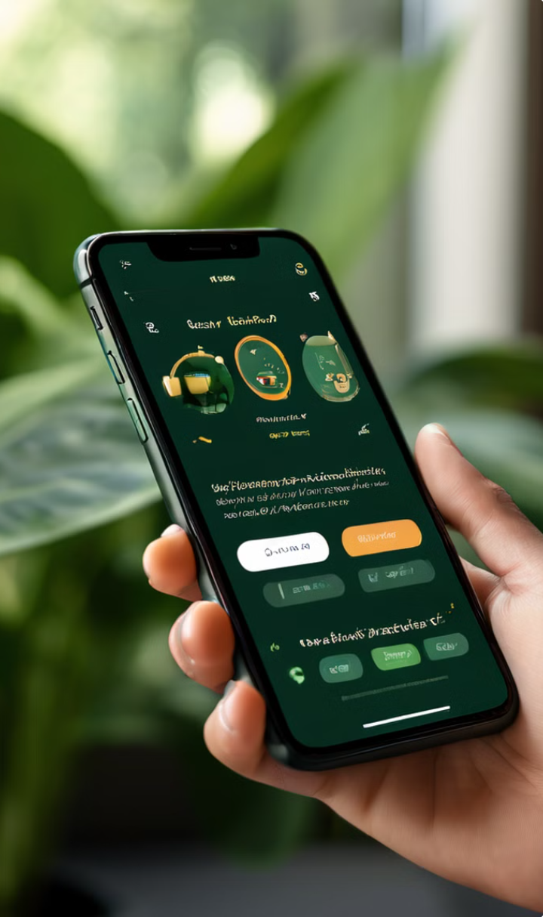




Mobile Development
The rise of mobile devices has made real-time translation accessible to a wider audience. Mobile apps offer convenience and portability, making translation available anytime, anywhere.
Resource Limitations
Mobile devices have less processing power and memory compared to desktop computers.
Connectivity Issues
Mobile translation apps rely on internet connectivity, posing challenges in areas with limited network access.
User Interface Design
Mobile app interfaces need to be intuitive and user-friendly for optimal user experience.
Efficient Algorithms
Optimized algorithms are crucial for ensuring smooth performance on mobile devices.

Slide 8
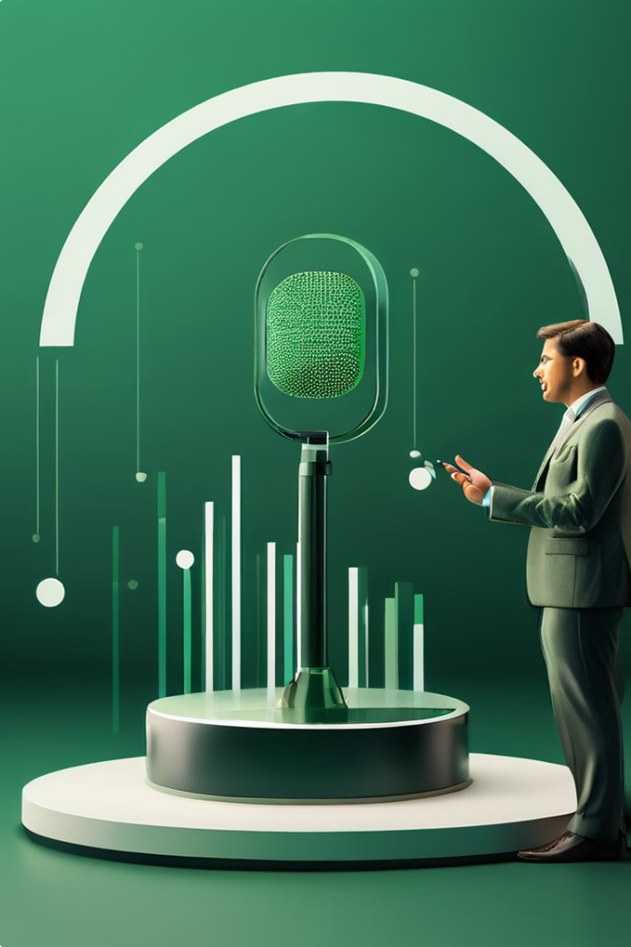
Speech Recognition
Speech recognition is the cornerstone of spoken language translation. It enables the translator to understand spoken words and convert them into written text for processing.
1
Acoustic Modeling
This step analyzes the acoustic characteristics of speech, recognizing the individual sounds and their variations.
2
Language Modeling
This step uses statistical models to understand the structure and grammar of the spoken language, predicting the most likely words based on context.
3
Decoding
The final step combines the acoustic and language models to convert the audio signal into a sequence of words, producing the final text output.

Slide 9

Future Directions and Conclusion
The field of real-time language translation is constantly evolving, driven by advancements in AI and machine learning. The future holds exciting opportunities for improved accuracy, expanded language support, and innovative applications that will further bridge language barriers.
1
Multimodal Translation
Combining text, speech, and visuals for a richer and more immersive translation experience.
2
Real-Time Collaboration
Integrating translation into collaboration tools, enabling seamless communication and teamwork across languages.
3
AI Advancements
Leveraging advanced AI and machine learning techniques to further improve translation accuracy, context awareness, and fluency.

Slide 10



Contact, Discussion, and Conclusion
Contact Us
Questions and Discussion
Thank You
For more information or to get involved, visit our website at
We welcome your questions and feedback. Please feel free to raise your hand or use the discussion chat to participate in the Q&A session.
Thank you all for your time and attention. We hope this presentation has provided valuable insights into the capabilities and future of real-time language translation.
Jaswanth Kollipara
or email us at info@kjaswanth28@gmail.com.

